Slide 1


DEPARTMENT OF ELECTRICAL AND ELECTRONICS ENGINEERING Internship Presentation on “SOLAR PV DESIGN” BY TINU TOM (4GW18EE048)
Geetha Shishu Shikshana Sangha(R)
GSSS INSTITUTE OF ENGINEERING & TECHNOLOGY FOR WOMEN (Affiliated to VTU, Belagavi, Approved by AICTE, New Delhi & Govt. of Karnataka)
Accredited with ‘A’ with NAAC K.R.S Road, Metagalli, Mysuru-570016
Under the Guidance of
Internal Guide
Ms. Apoorvashree H L
Assistant Professor
Dept of EEE,GSSSIETW
External Guide
Naveen Kumar Dubey
Training & Research associate
Skilldzire

Slide 2


Contents
About the Company
Introduction
Objectives
Types of Solar PV Systems
Types of Thermal Systems
Solar energy development
Major components in solar PV power plants
Configuration of Solar PV System
Design a Solar PV power plant
Advantages of Solar PV Systems
Applications
Conclusion

Slide 3

About the Company
Skilldzire Technologies Private Limited is an unlisted private company incorporated on 16 October, 2020. It is classified as a private limited company and is located in Rangareddi, Telangana.
Skilldzire Technologies Private Limited has two directors - Sreedhar Thokala and Srikanth Muppalla.
The company provides training for Engineering students in different technologies.

Slide 4
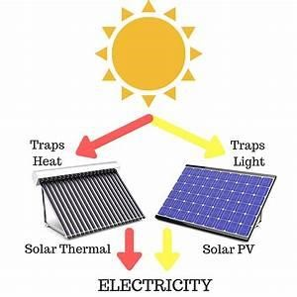
Introduction
What is Solar Energy?
Solar energy is the energy the earth receives from the sun, primarily as visible light and other forms of electromagnetic radiation.
We are utilizing solar energy in two types:
Light Energy (Photovoltaic)
Heat Energy (Thermal)
Fig 1 light and heat energy

Slide 5

Objectives
To understand the importance of solar energy and utilize them in the correct way by using the latest technology.
To know the different types, advantages and applications of solar PV modules

Slide 6
Types of Solar PV Systems
Solar Rooftop Power Plants
2) Solar Utility Scale Power Plants
Solar Grid- Connected/ On Grid/ Grid – Interactive Systems
Solar Off- Grid Systems
Solar Hybrid Systems
Solar Agriculture Pumps
Solar Ground Mounted Power Plants
Solar Floating Power Plants

Slide 7
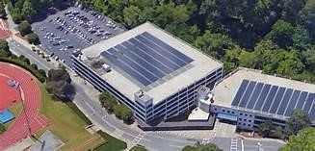
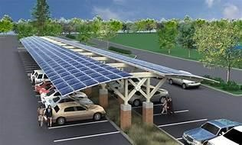
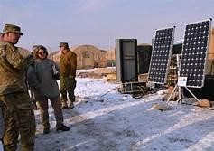
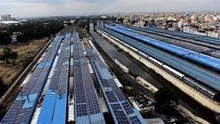
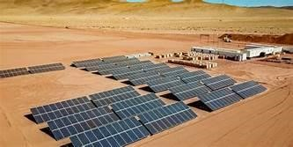
Solar Rooftop Power Plants
Solar Grid- Connected/ On Grid/ Grid – Interactive Systems
Solar Off- Grid Systems
Schools and hospitals
Parking lots
Army camps
solar grid plant at backward areas
Solar on metro and railway

Slide 8

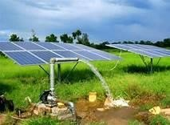
Solar Hybrid Systems
Solar Agriculture Pumps
Residential Buildings, Gated Communities, Apartments
Agriculture water pump

Slide 9
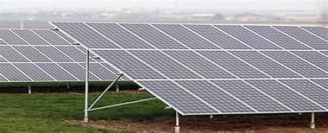
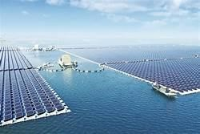
Solar Utility Scale Power Plants
Solar Ground Mounted Power Plants
Solar Floating Power Plants

Slide 10
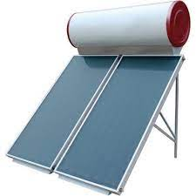
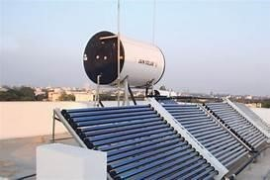
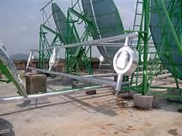
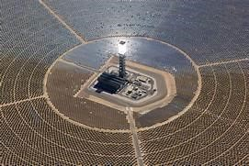
Types of Solar Thermal Systems
Solar FPC (Flat Plate Collector System)
Solar ETC (Evacuated Tube Collector) System
Solar Steam Cooking Systems
Concentrated Solar Power Plants

Slide 11

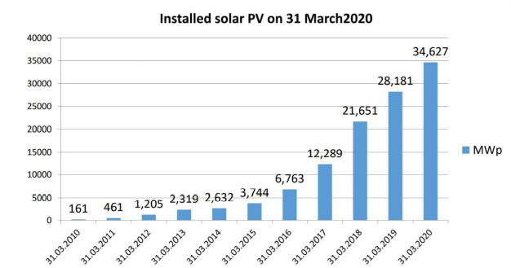
SOLAR ENERGY DEVELOPMENT
Solar power is a fast-developing industry in India.
The country's solar installed capacity was 34,627 MW (35.7 GW & Rooftop 2.1GW) as of 31 August 2020
The Indian government had an initial target of 20 GW capacity for 2022, which was achieved four years ahead of schedule.

Slide 12
Major Components in Solar PV Power Plants
Solar PV Modules
Inverter
Solar Module Mounting Structure (MMS)
Balance of System (BoS)

Slide 13
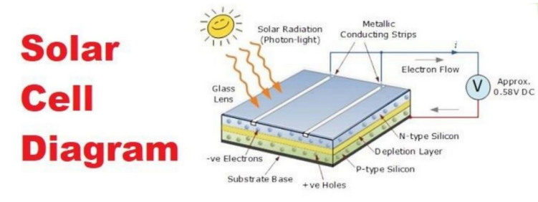
Solar PV Modules

Slide 14
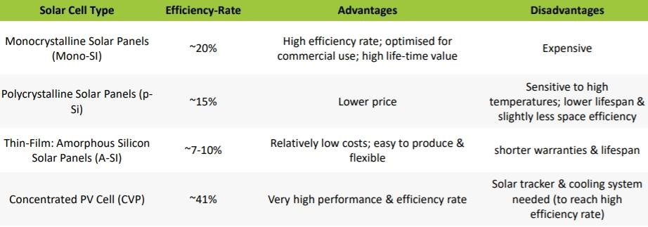
Types of Solar PV Modules

Slide 15
Inverter
Solar inverter converts the DC power to AC power to facilitate feeding to the regular loads.
The output from the inverter will be fed to the AC distribution Board.

Slide 16
Types of Solar PV Grid Connected Inverters
1. String Inverters (1 kW – 100 kW)
2. Central Inverters (500 kW – 2000 kW)
3. Micro Inverters (350W – 500W)
4. Optimizer Based Inverters (Solar Edge Inverters) (2.5 kW – 50 kW)

Slide 17
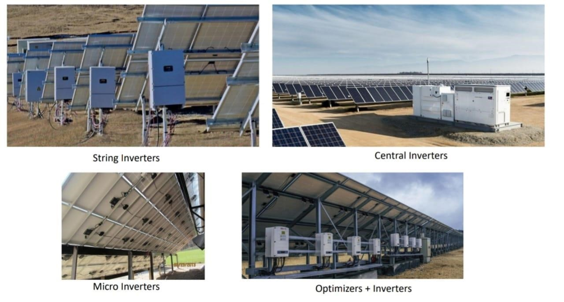

Slide 18
Module Mounting Structure (MMS)
The Panels will be mounted on the Ground/Roof using custom structural components to achieve optimum direction and tilt angle in order to maximize the efficiency of the system.

Slide 19
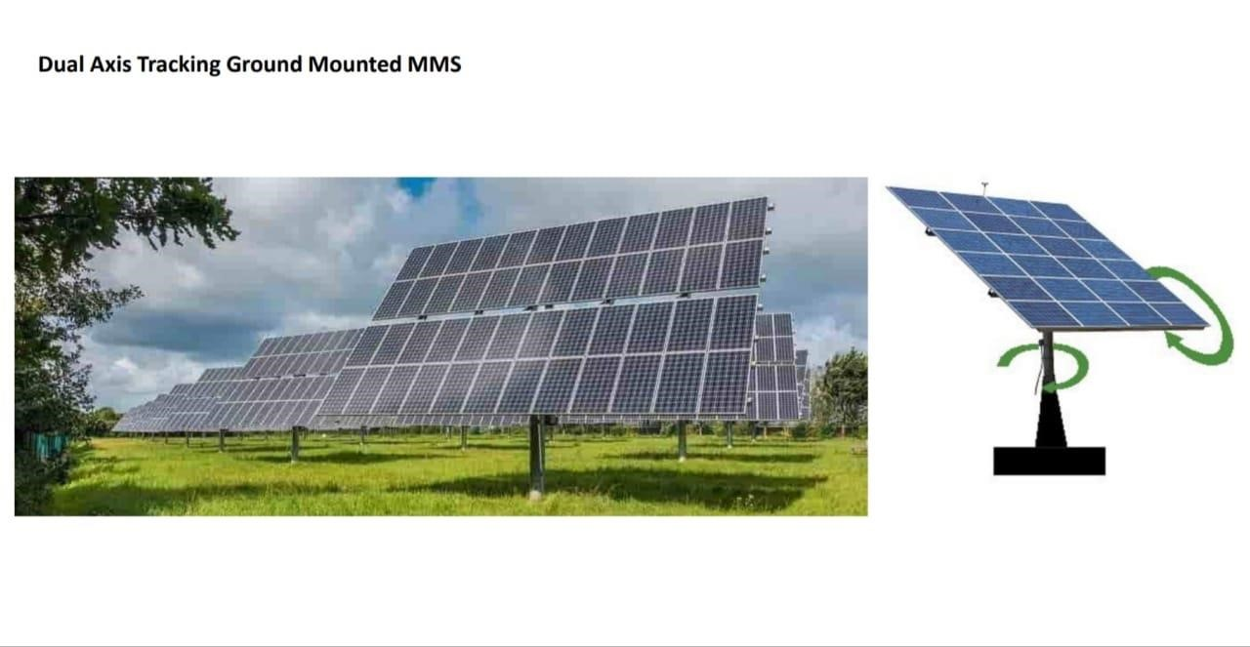
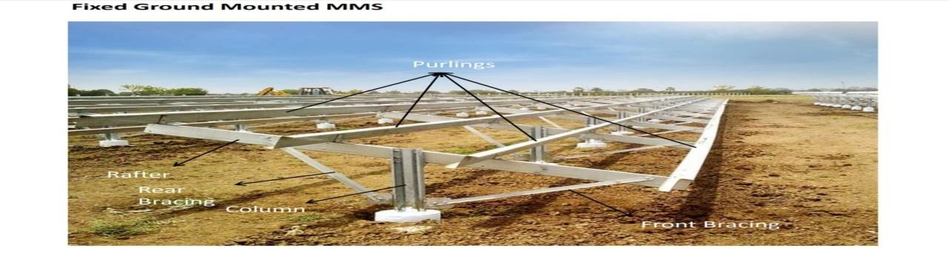
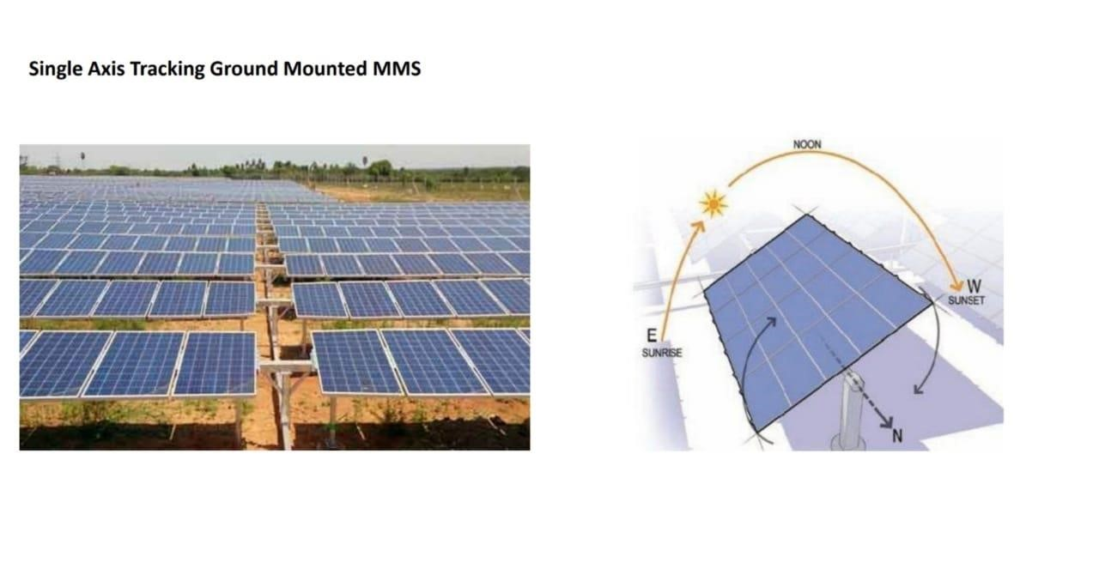
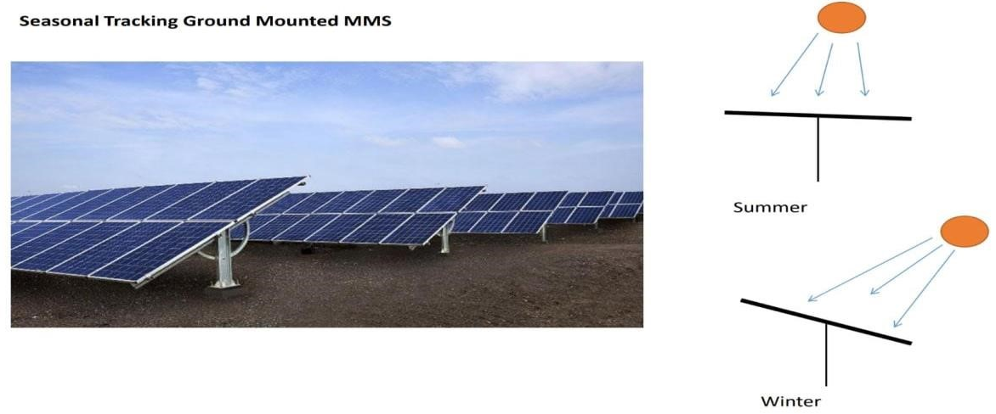
Types
1. Ground Mounted MMS

Slide 20
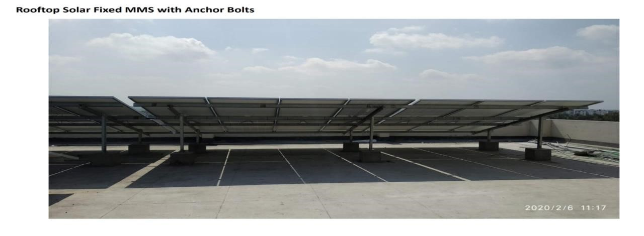
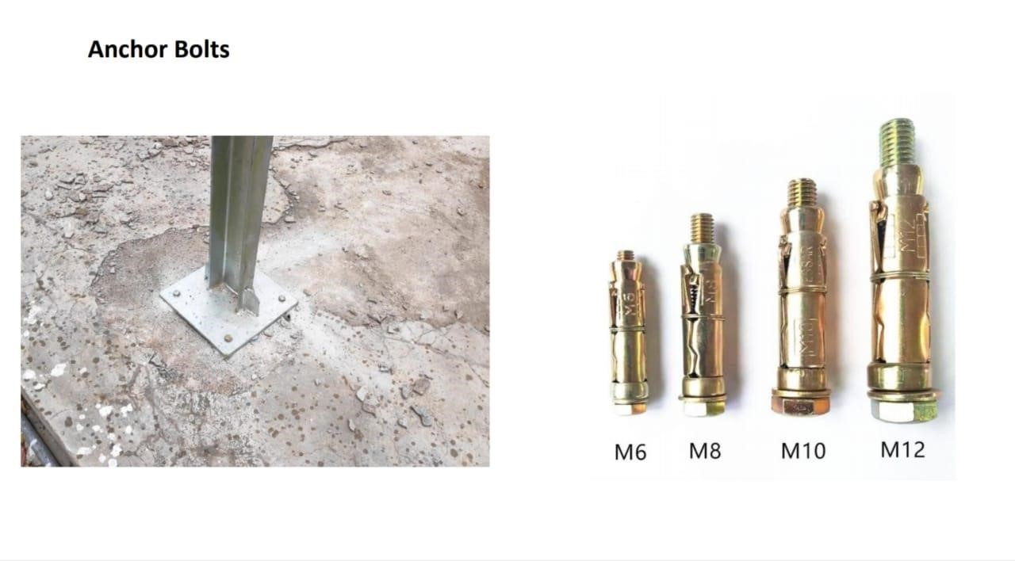
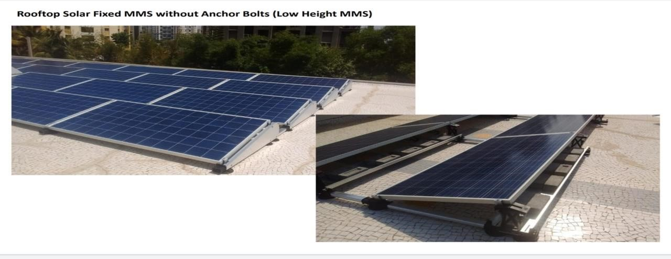
2. Rooftop MMS

Slide 21
Balance of System (BoS)
MC Connectors
DC Cables
AC Cables
Earthing Material
Lightening Arrestor
Other Electrical Accessories

Slide 22
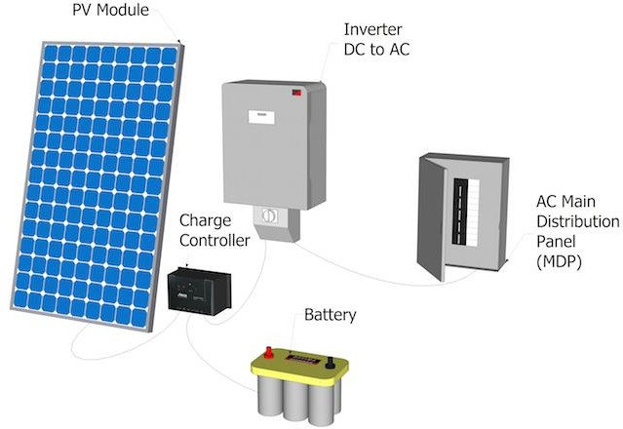
Configuration of Solar PV System

Slide 23
TO DESIGN A SOLAR PV POWER PLANT FOR ANY ORGANIZATION/ INDUSTRY / RESIDENCE
12 Months Electricity Power Bills.
Shadow free area details.
Connected Load Details.

Slide 24
Ex - Residential Project
Average Electricity Consumption: 1250 kWh /per month
Connected Load: 15 kW
Geographical Location Details: 17°23'14.34"N, 78°20'2.30"E (1036 sq.f / 90 sq.m )
Connected Always =>PV Plant Capacity Shadow free area available : 86.4 Sq.m 1 KWp
Solar Power Plant Required Space is : 8 Sq.m
Per Day Consumption: 1250 kWh /30 Days = 41.6 kWh
Solar PV Plant Capacity: Per Day Consumption / Average Solar Generation per Day
(4 kWh) : 41.6 kWh / 4
Solar PV Plant Capacity: 10.4 kWp
Solar PV Plant Capacity Based on Area :
=Available Shadow Free Area/ 1 KWp Solar Power Plant Required Space
86.4/8 = 10.8 kWp

Slide 25
How to calculate Battery Backup Sizing ?
3 BHK Independent House
4 Fans –80 Watt x 4 = 320 Watt
8 Lights -20 Watt x 8 = 160 Watt
1 TV –100Watt x 1 = 100 Watt
1 Fridge –200 Watt x1 = 200 Watt
= 780 Watt -Actual Inverter Capacity = 780/ 0.8 = 975 W –1000 Watt/1 kW
They need back for 4 Hours @ full Load
Energy Requirement : Power x Time =780Watt x 4 = 3120 Wh
Battery Capacity : Total Energy Requirement / Battery Nominal Voltage = 3120Wh/12V = 260 Ah
Depth of Discharge (DoD) = 80%
Actual Battery Requirement of Battery Capacity = Required battery Capacity / DoD% = 260Ah/0.8 = 325Ah
Required battery is 12V, 165Ah –2 No’s
As per manuafcturer-A Inverter Rating –1 kW, 12Vdc –Parallel 2 No’s batteries of 12V, 165Ah = 12V, 330h
As per manuafcturer-B Inverter Rating –1 kW, 24Vdc –Series 2 No’s batteries of 12V, 165Ah = 24V,165Ah

Slide 26
Advantages of Solar PV System
A clean and green energy source
Free raw materials
Reduced costs
Low in maintenance
Silent
Easy to install

Slide 27
Applications of Solar PV Systems
Photovoltaic systems can be used to supply electricity for:
Water pumps
Laptop computers
Cottages and remote residences
Parks in remote regions
Supplying occasional power

Slide 28
Conclusion
Understood the importance of solar energy and utilized them in the correct way by using the latest technology.
Came to know the different types, advantages and applications of solar PV modules

Slide 29
Thank you

